Slide 1
Introduction to Bioanalytical Techniques
Wilson Huang

Slide 2
Table of contents
DNA, RNA, Proteins
Cloning Cycle
01
02
DNA Sequencing and Tissue Staining
03
Western Blot, ELISA
04
Structure and Function
PCR, Restriction Digest, Ligation, Gel Electrophoresis
Analyzing Proteins
Clinical approaches

Slide 3
01
Objectives
Biomolecules
Review the basics of what even is a DNA, RNA, and protein

Slide 4
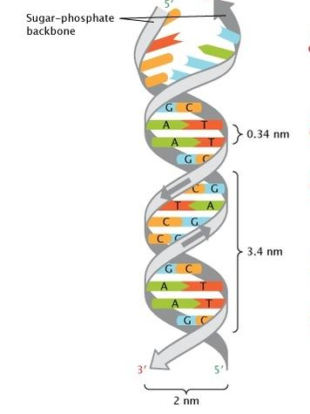
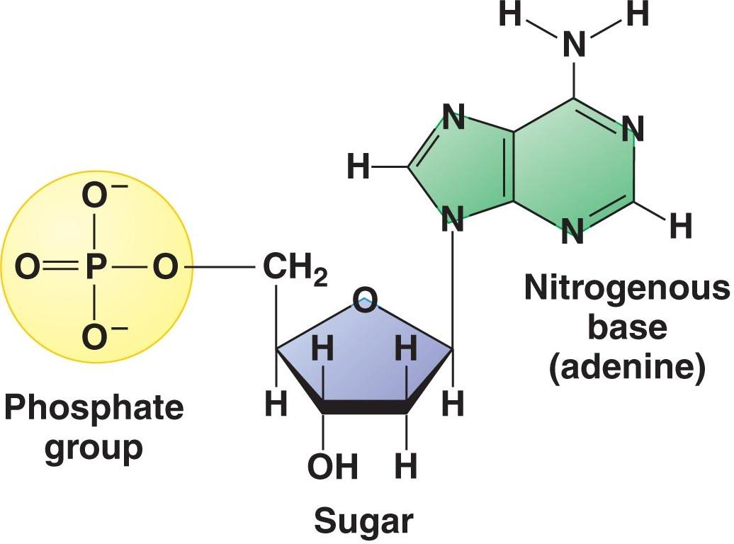
DNA - A sequence of nucleotides
Nucleotide Structure:
General Structure:
Two helical chains coiled around the same axis
The chains are anti-parallel
Sugar-Phosphate backbone outside, bases inside

Slide 5
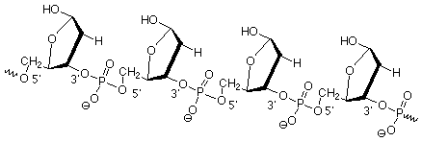
DNA Backbone
Phosphodiester Bond
Phosphate groups joins the 3’ carbon of one sugar molecule to the 5’ carbon of another sugar molecule

Slide 6
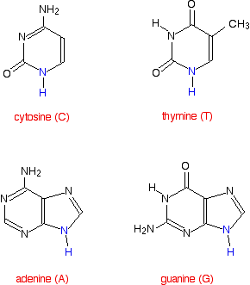
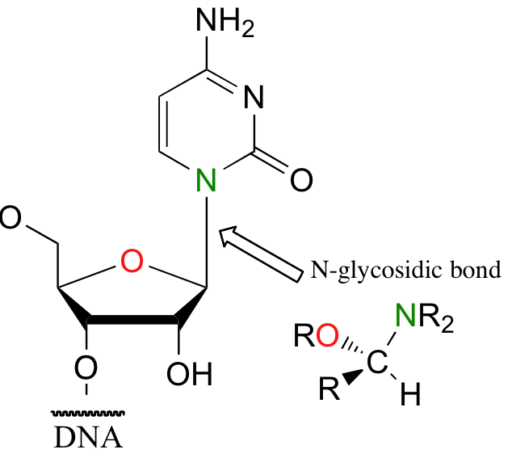
DNA Nitrogenous Base
Pyrimidines
Cytosine
Thymine
Purines
Adenine
Guanine
N-glycosidic bond
Between the 1’ carbon in pentose sugar and 9’ nitrogen in purine bases and 1’ nitrogen in pyrimidine bases

Slide 7
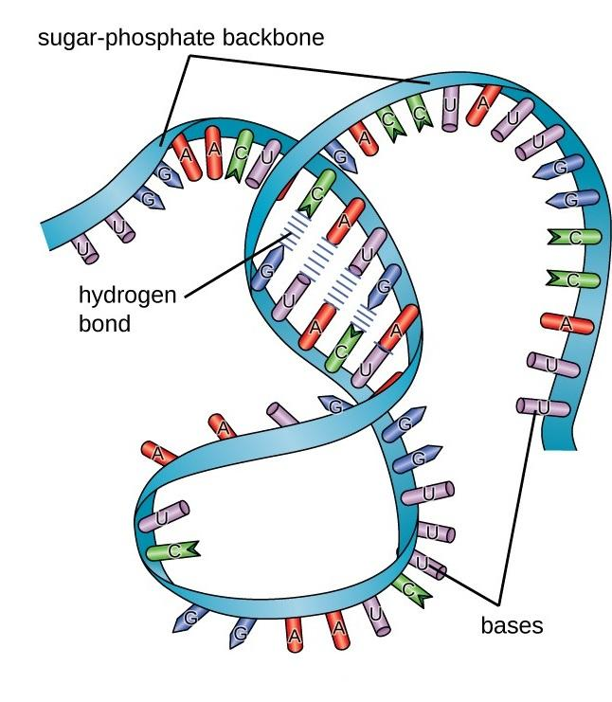
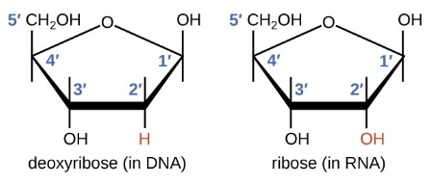
RNA
Nucleotide Structure:
Same as DNA except:
Pentose sugar is ribose
Hydroxyl group at the 2’ carbon
Has a different nitrogenous base
General Structure:
Single stranded molecule
Folds up in a variety of shapes

Slide 8
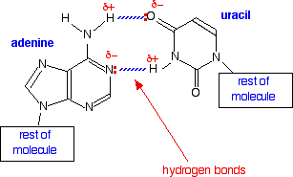
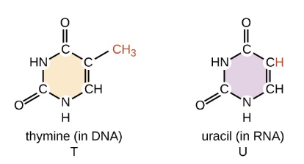
Uracil in RNA
Uracil replaces Thymine
Pyrimidine
Binds to Adenine with 2 Hydrogen Bonds

Slide 9
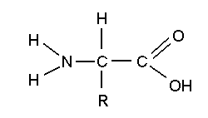
Proteins - Polymers of Amino Acids
Amino Acid Structure:
Amphoteric and Zwitterionic
Carboxyl Group
Amine Group
R Group
20 amino acids
E.g. valine, raline, histidine

Slide 10
Primary Protein Structure
Linear Sequence of Amino Acids
Peptide Bonds
Dictated by Genetic Code

Slide 11
Secondary Protein Structure
Helices or Pleats in the Polypeptide
Main types
Alpha Helix
Beta Pleats
Form as a result of hydrogen bonding
Between repeating constituents of the polypeptide backbone

Slide 12
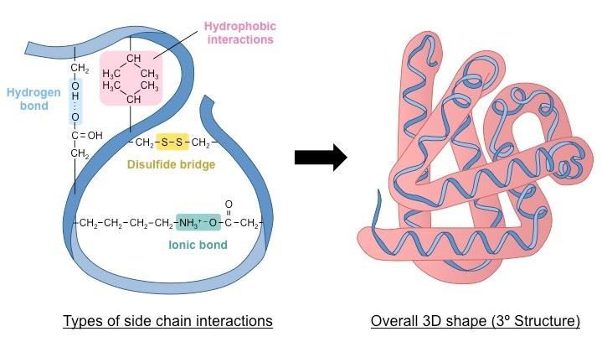
Tertiary Protein Structure
Fold in specific ways due to interactions between R groups
Ionic Bond
Hydrogen Bond
Hydrophobic Interactions
Disulfide Bridge

Slide 13
Quaternary Protein Structure
Two or more polypeptide aggregate
Forms 1 function protein
E.g. Hemoglobin - Globular Protein
E.g. Collagen - Fibrous Protein

Slide 14
02
Objectives
Cover basics experiments to run the cloning cycle

Slide 15
The Cloning Cycle
Transformation and Cultures
DNA Isolation
Restriction Digest
Gel Electrophoresis & Purification
Ligation
Retransform & Colony PCR
Purify out the plasmid DNA
Plasmid DNA replication
Cut the DNA at specific parts
Separate DNA fragments
Joining together different DNA fragments
Replicate DNA and check

Slide 16
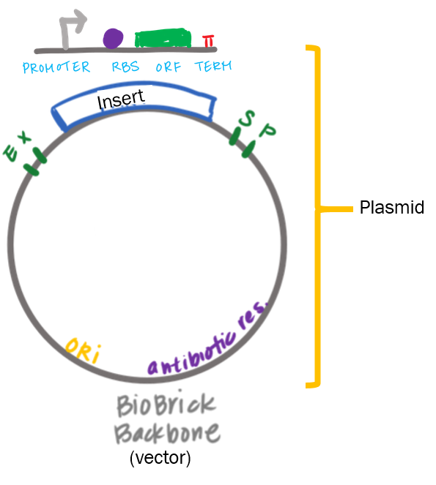
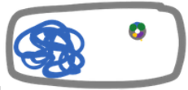
Transformation Principle
Deliver plasmids into bacteria
To replicate the plasmid
To make proteins

Slide 17
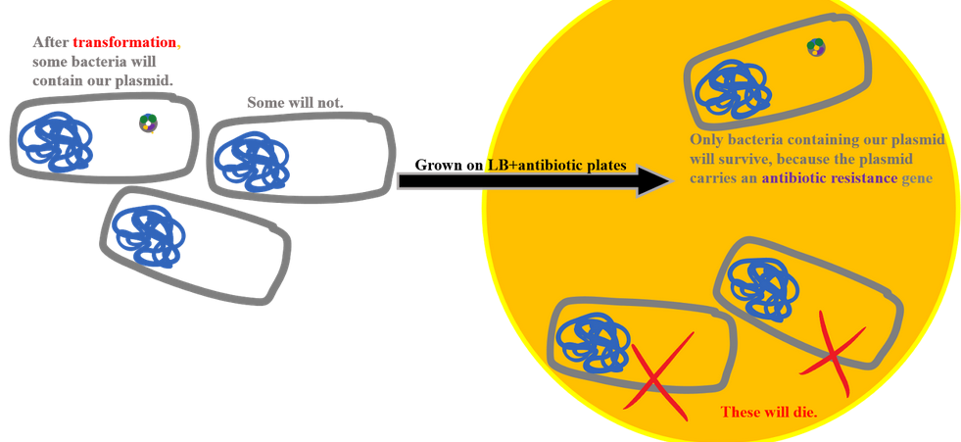
Transformation Principle
Antibiotic Resistance selects for the bacteria containing out plasmid

Slide 18
Transformation Protocol
1. Cells made competent before use, usually by treatment with CaCl2
Makes bacterial cell membrane more permeable
2. Incubate competent cells & DNA on ice
Foreign DNA mixed together with bacterial cells
3. Heat shock at 42 °C for 30-45s
Transiently opens up pores in cell membrane so foreign DNA can enter
4. Brief incubation on ice
Closes pores in cell membrane
5. Plate bacterial cells on LB + an antibiotic that only allows growth of transformed cells

Slide 19
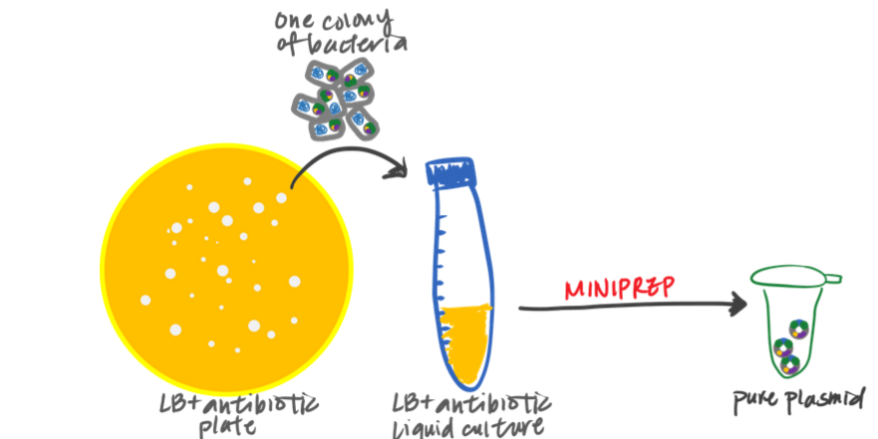
Liquid Cultures
Prepare Bacterial Liquid Cultures
Add LB, antibiotic (1000x), and one single bacterial colony into a conical tube
Pick single bacterial colony from agar plate using pipette tip and pipette and release the tip
Incubate at shaking incubator 37ºC (loosened cap with tape, slanted) - overnight

Slide 20
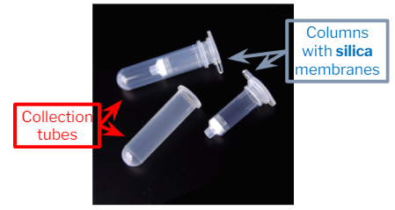
DNA Isolation - Principle
Commercial kits use “columns” that have a silica membrane
DNA binds to silica under high salt conditions
Use this property to isolate DNA

Slide 21
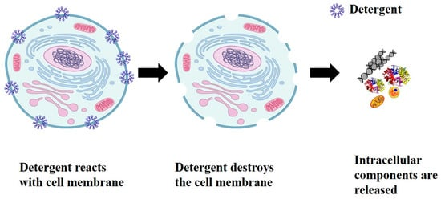
DNA Isolation - Protocol
Overview of Steps:
Grow cells in liquid media & collect cells
Resuspend cells (Buffer PD1)
Lyse cells (Buffer PD2)
SDS disrupts lipid membrane
Alkaline solution denatures proteins and DNA
Neutralize cells (Buffer PD3)
Neutralize alkaline conditions (plasmids can renature)
Contain high salt
Centrifuge
Spin down large cell debris
Plasmid DNA small enough to stay in supernatant
Bind plasmid DNA to silica membrane in column
Wash
Elute plasmid DNA (with low-salt buffer) into clean tube

Slide 22
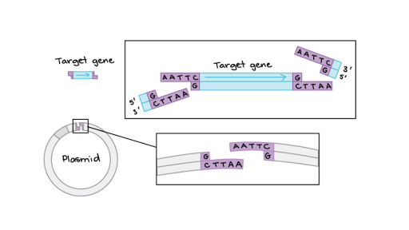
Restriction Digest Principle
Restriction enzymes cut at specific sequences on the plasmid

Slide 23
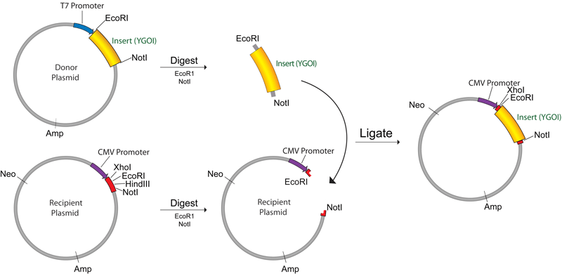
Restriction Digest Protocol
Add water, buffer, DNA, and enzymes and incubate at 37ºC for 1-4 hours

Slide 24
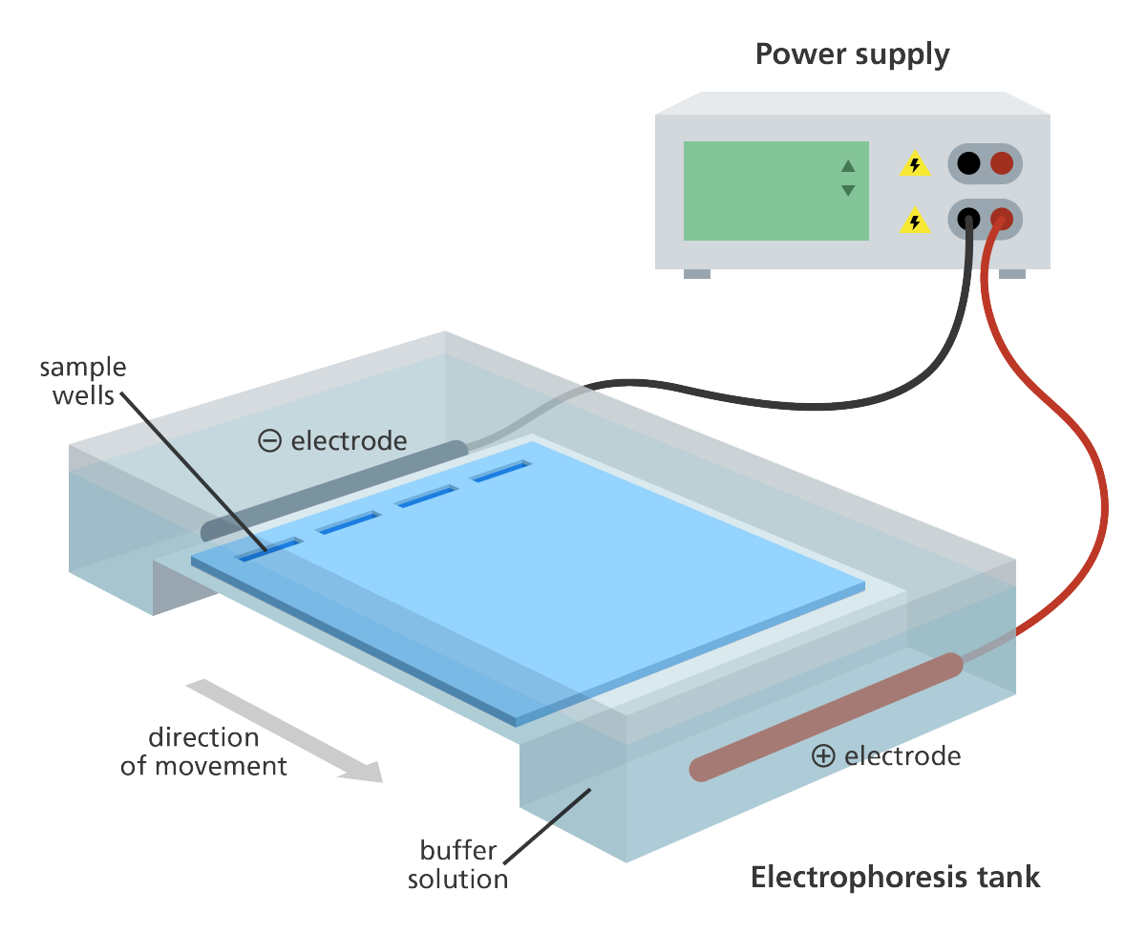
Gel Electrophoresis Principle
Separate the different fragments of DNA after cutting

Slide 25
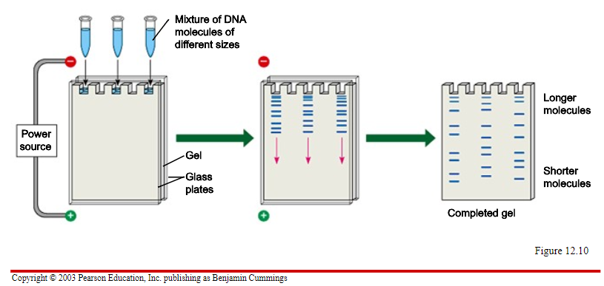
Gel Electrophoresis Principle
Gel apparatus connected to a positive and negative electrode
What is the charge of DNA?
Which electrode will it move toward?
Smaller pieces of DNA will travel faster

Slide 26
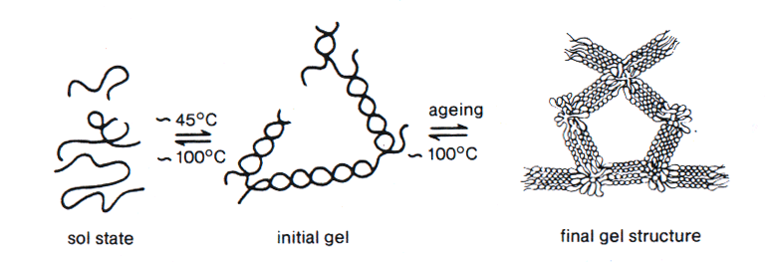
Gel Electrophoresis Principle
Agarose Gel - Porous Material
Solid state: single-stranded molecules
Boiled: molecules form helices with each other
Cooled: jello-like final product

Slide 27
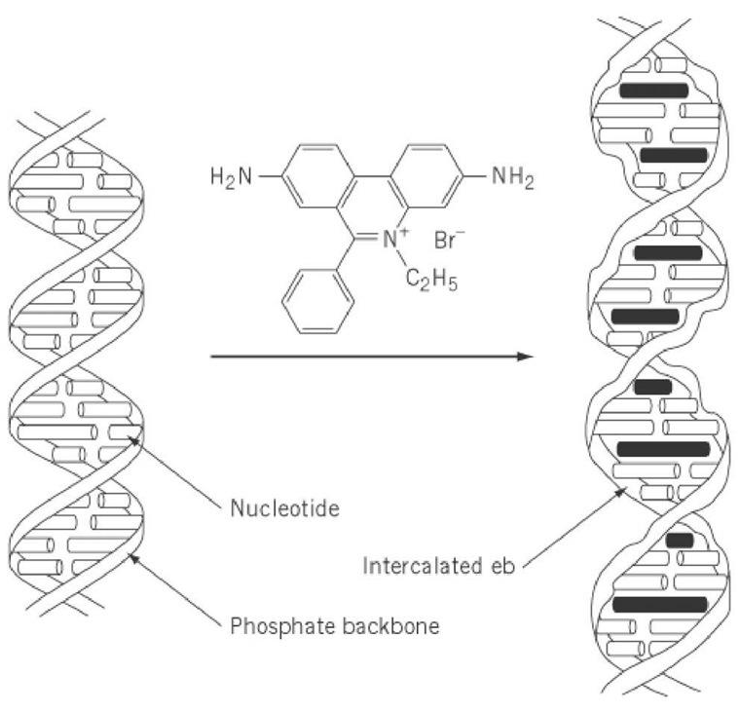
Gel Electrophoresis Principle
DNA Dye for Agarose Gels - Allows us to visualize DNA bands
Conventional dye: ethidium bromide
Works by inserting itself into DNA
Causes mutations in DNA
Carcinogenic
Safer alternatives now
We use SeeingSafe
Binds to DNA, but not toxic
Visualize bands under UV light
ethidium bromide

Slide 28
Gel Electrophoresis Principle
DNA Loading Dye
Weighs down DNA in wells
Visible, to track progress
DNA Ladder (Geneaid 1kb)
Mimics known DNA sizes

Slide 29
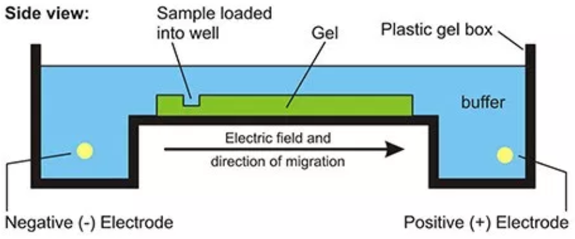
Gel Electrophoresis Protocol
Set up tank: fill with 1x TAE buffer
Prepare DNA samples
Mix 6x DNA loading dye with 2uL of DNA
How much distilled water do you add?
3. Load samples into wells
4. Run gel at 100V for ~20 min.

Slide 30
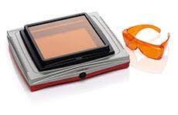
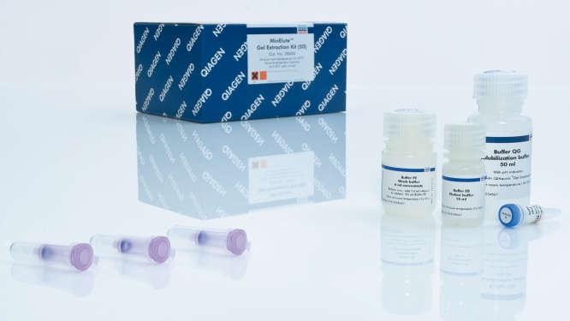
Gel Cutting and Purification

Slide 31
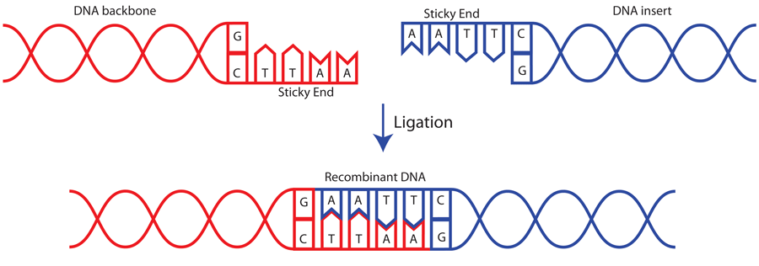
Ligase Principle
DNA ligase enzymes join together the ends of DNA strands

Slide 32
Ligation Protocol
Calculate molar ratio of insert and vector
Add the vector, insert, ligase buffer, ligase, and water into a tube
Incubate in room temperature for 1-3 hours

Slide 33
Retransform
Deliver the new plasmid into bacteria

Slide 34
3 in 1 Colony PCR
Select a colony using a pipette tip
Dip colony in PCR tube for subsequent analysis
Check if the DNA product is right
Re-streak colonies
New bacteria colonies with desired DNA inside
Dispense tip into liquid culture
Can miniprep for more DNA samples

Slide 35
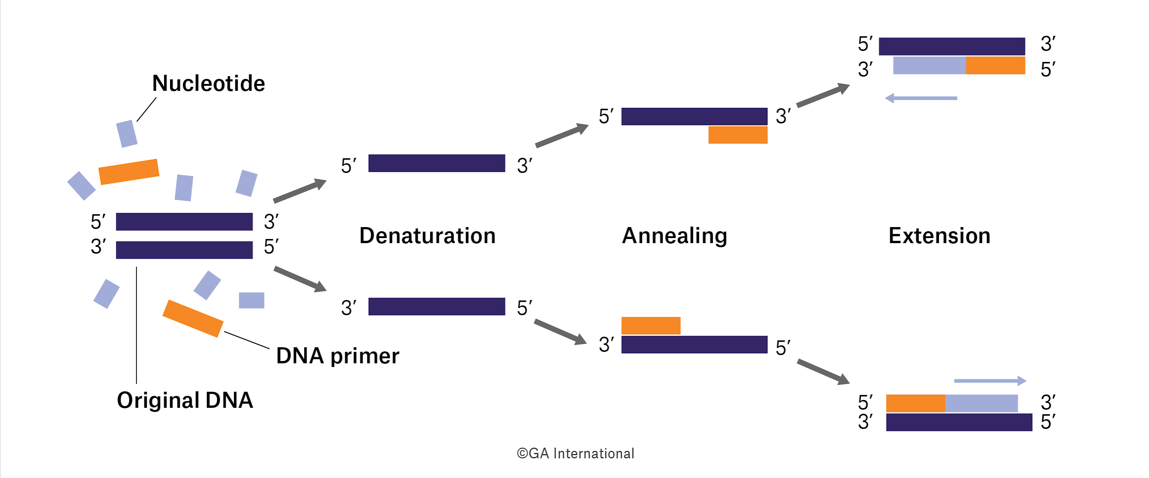
PCR - Principle
Denaturation
Annealing
Extension

Slide 36
PCR - Protocol
Add water, 1 bacterial colony, forward primer, reverse primer, Taq DNA Polymerase
Run heat cycles of 95ºC (denature), 55ºC (annealing), 72ºC (elongation) on a thermocycler
Run on gel to check if the DNA product matches the expected size

Slide 37
03
Objectives
Learn how to analyze proteins using ELISA and Western Blot

Slide 38
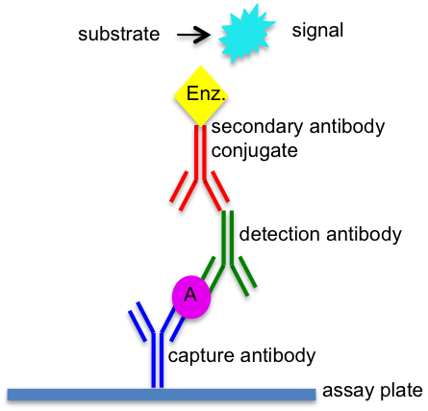
Sandwich ELISA Principle
Selectively capture proteins using antibodies
Detecting and secondary detecting antibodies amplify the signal that is produced (usually change in color)

Slide 39
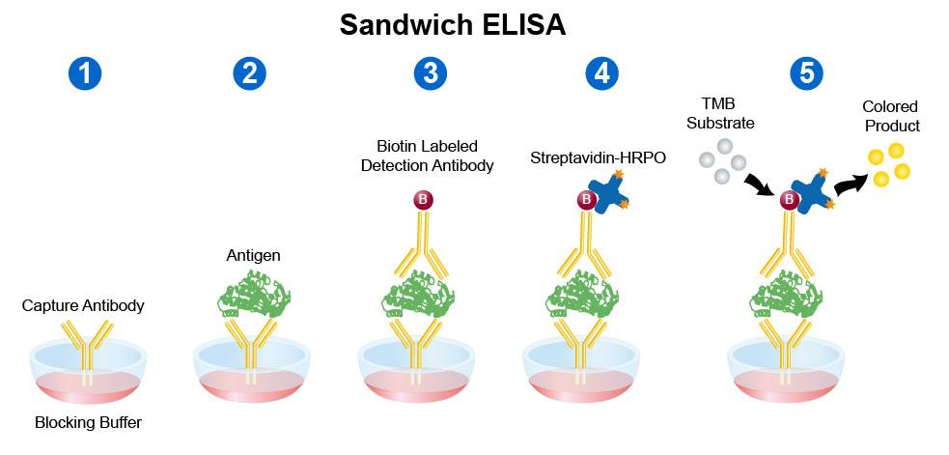
Sandwich ELISA Protocol
Coat wells with capture antibody and incubate overnight
Wash out coating solution and add milk to block protein-binding sites not from antibodies
Wash samples with PBS and add lowering dilutions of protein samples and standard solutions with known concentrations
Add detecting antibody and secondary detecting antibody conjugated with HRP (Horseradish Peroxidase) enzyme
Add TMB substrate to yield blue color

Slide 40
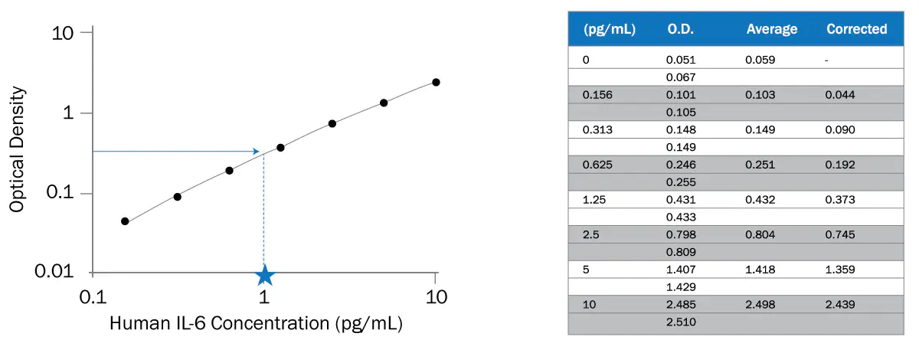
Sandwich ELISA Data Analysis
Plot a curve of the optical density (measurement of color in wells) over the known concentration of standards
Then use the equation of the curve to solve for the concentration of the protein sample (plug in the optical density measurements)

Slide 41
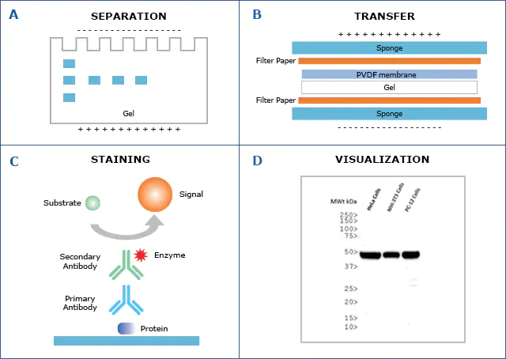
Western Blot Principle and Protocol
Protein gel electrophoresis can separate proteins by size
Transfer proteins onto a membrane - porous for antibody staining
Same concept of ELISA, a signal is produced
The signal on the membranes can be visualized and imaged

Slide 42
04
Objectives
Understanding techniques used in clinical practice

Slide 43
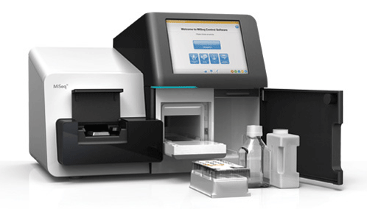
Next Generation DNA Sequencing Principle
Used for highly accurate DNA sequencing of clinical samples:
Can be used to determine mutations - cancer and other diseases
Different than traditional sequencing because of sample library preparation and more advanced PCR steps

Slide 44
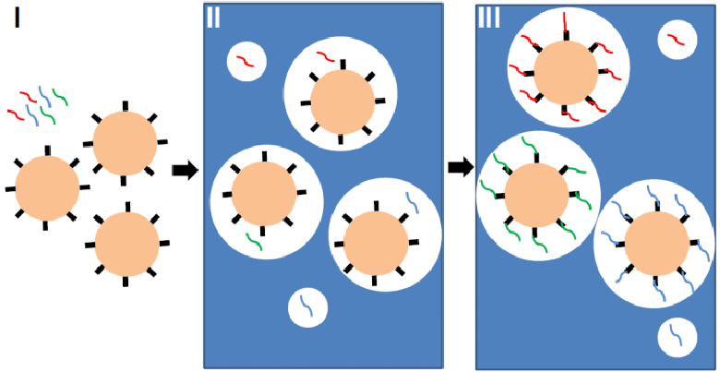
Next Generation DNA Sequencing Principle
Sample Library Preparation:
Templates are digested, ligated, elongated
Adapters are added (to attach to beads)
Amplified
Emulsion PCR:
Magnetic beads with library of DNA are amplified in oil droplets - DNA enrichment

Slide 45
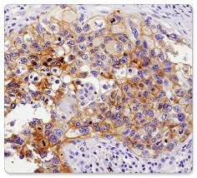
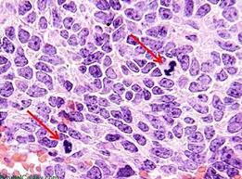
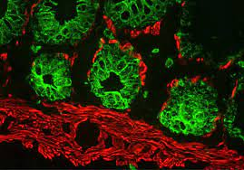
Different types of Staining
IHC (Immunohistochemistry)
Detect protein biomarkers
H&E Staining
Hematoxylin - stains for nuclei
Eosin - cytoplasm
Immunofluorescence Staining
Detect protein biomarkers with fluorescence

Slide 46
Thanks!
Do you have any questions?
whuang58@jh.edu
@wilson.huang.1004
Please keep this slide for attribution

